Slide 1


React + MobX Morar Ioan Adrian

Slide 2
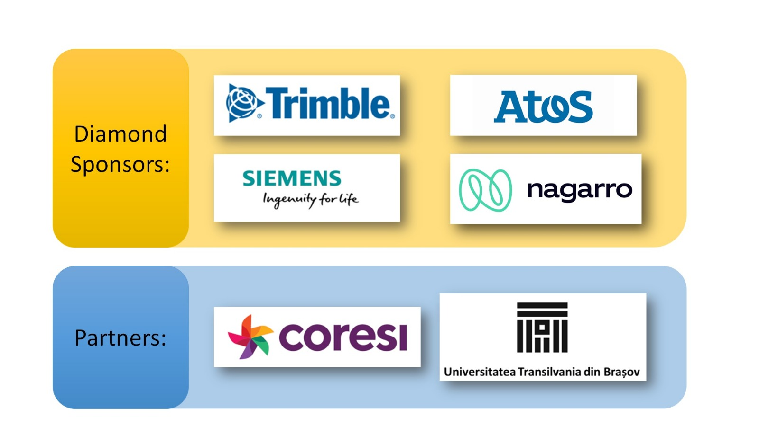

Slide 3



Who am I?
I don't know exactly
In 2010, I started working like freelancer in web and graphic design.
In 2014 I got a job like Full-Stack Developer (C#, .NET, Javascript etc)
Starting with 2016, I was focused more on the FrontEnd side.
Today I work like FrondEnd developer in an application where we have React + Redux, React + ContextAPI, React + MobX

Slide 4
Agenda:
React app (using lifting state up concept)
installing and configuring the MobX
migration of the app to use MobX
Q&A

Slide 5


What do you expect from this course?
www.menti.ro
Code: 87 20 86 6

Slide 6
What React is?
React is a declarative, efficient, and flexible JavaScript library for building user interfaces.
It lets you compose complex Uis from small and isolated pieces of code called “components”.
More about React

Slide 7
Installation of the create-react-app
npm install create-react-app –g
create-react-app cars
npm run eject
npm install --save-dev @babel/plugin-proposal-class-properties
More about React

Slide 8
Instalation of the create-react-app
Create “.babelrc” and add:
{
"presets": ["react-app"],
"plugins": [[
"@babel/plugin-proposal-class-properties",
{
"loose": true
}
]]}

Slide 9
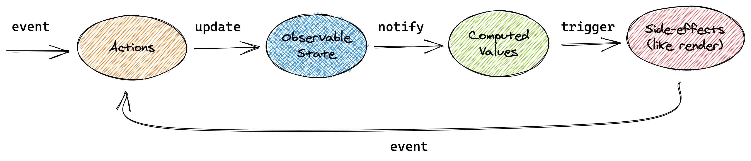
What MobX is?
MobX is a tested library that makes state management simple and scalable by transparently applying functional reactive programming.

Slide 10
Instalation
MobX works in any ES5 environment, which includes browsers and NodeJS
npm install –save mobx mobx-react

Slide 11
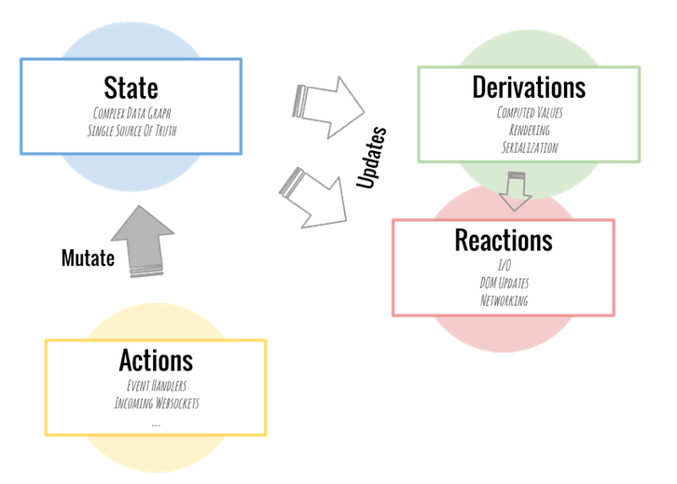
The core idea

Slide 12
STORE
The main responsibility of stores is to move logic and state out of your components into a standalone testable unit that can be used in both frontend and backend JavaScript.
Most applications benefit from having at least two stores: one for the domain state (keep data, consume api etc) and another one for the UI state (keep data about the UI). The advantage of separating those two is you can reuse and test domain state universally, and you might very well reuse it in other applications.

Slide 13
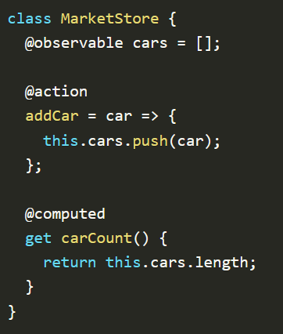
STORE

Slide 14
OBSERVABLE
Properties, entire objects, arrays, Maps and Sets can all be made observable.
The basics of making objects observable is specifying an annotation per property using “makeObservable”
MORE DETAILS

Slide 15
ACTIONS
An action is any piece of code that modifies the state. In principle, actions always happen in response to an event. For example, a button was clicked, some input changed, a websocket message arrived, etc.
MobX requires that you declare your actions, although “makeAutoObservable” can automate much of this job.
MORE DETAILS

Slide 16
COMPUTED
Computed values can be used to derive information from other observables.
They evaluate lazily, caching their output and only recomputing if one of the underlying observables has changed.
MORE DETAILS

Slide 17
autorun
The autorun function accepts one function that should run every time anything it observes changes. It also runs once when you create the autorun itself. It only responds to changes in observable state, things you have annotated observable or computed.
MORE DETAILS

Slide 18
Q
A
&

Slide 19

FEEDBACK
Send it now
It takes 2-3 minutes
Anonymous feedback - for trainer and AgileHub
http://bit.ly/peakit003-feedback

